Slide 1
Vaka:
Navigating Pacific Postgraduate Horizons
Jemaima Tiatia-Seath
Co-Head, School of Māori Studies and Pacific Studies & Head of Pacific Studies (Acting)

Slide 2
Hau’ofa, E. 1991. Our Sea of Islands, The Contemporary Pacific 6 (1): 148-61

Slide 3
Vaka is an interdisciplinary Pacific PG research and knowledge hub (Honours, PG Diploma, Masters, Doctoral, and Postdoctoral).
Primary aim: to develop and nurture a critical mass of Pacific PG students and staff, to enhance student learning by exploring new horizons and shaping student excellence.
Vaka’s success: it observes and promotes Pacific diversity, epistemologies and pedagogies.
It cultivates Pacific student-academic-community connectivity, reciprocity, and collaboration.
The linking in of Pacific staff, and networking with community leaders and funders, enables students to aspire to, Pacific leadership in academia and in the workforce at large.

Slide 4
2017 Activities
Meet and greet
Writing workshop: journal article submission process and thesis writing structures, facilitated by CLeaR – Dr Susan Carter
HRC Career Development Award application writing workshop facilitated by HRC’s Pacific Research Manager
Regular Canvas, email and FB updates around scholarships, research, PG tips, and employment opportunities.
Supervisors’ input: Sourcing funding streams for students to present at national and international conferences and ongoing mentoring and development of young emerging Pacific researchers.
A three-day writing retreat at Vaughan Park, Long Bay, which allowed students to complete journal articles, grant applications, book chapters and theses chapters
The role of the Vaka coordinator has been effective. Further leadership opportunities have derived for the coordinator as a result of Vaka duties. For instance, academic course-coordination at Pacific Studies.

Slide 6
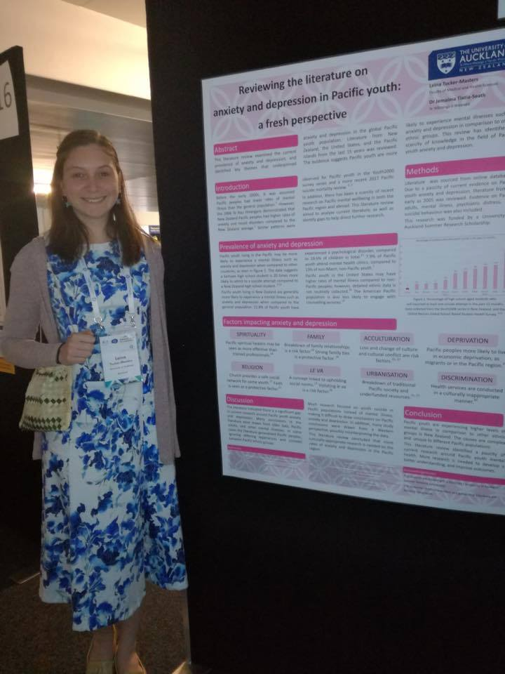
Pathways
Leina-Tucker Masters
FMHS Summer Studentship (poster winner at the Royal Australian & NZ College of Psychiatrists conference).
HRC Pacific Health Research Summer Studentship.
Honours in medical programme.

Slide 7
Publication: First author in the NZ Medical Student Journal.
Open access.

Slide 8
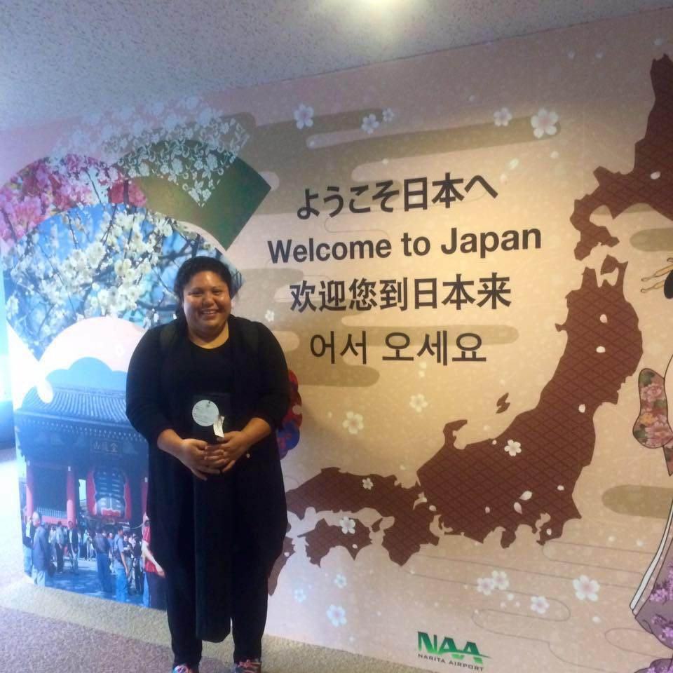
Eliza Puna
PhD Candidate HRC funded
Conference presentations
Cook Islands Language
Potential Postdoc

Slide 9
Publication: First author in the Journal of Indigenous Wellbeing
Open access

Slide 10
Caleb Marsters
PhD Candidate HRC funded
2x Accepted book chapters (1 international)
Conference presentations
Vaka coordinator
Teaching across Pacific Studies courses

Slide 11
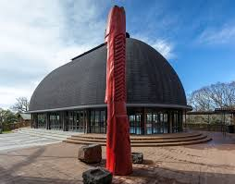
2018 & Beyond
Now based solely out of Pacific Studies
Welcomes other PG’s across UOA
Continue with this winning formula
Seek more funding avenues for operational costs and scholarships for students
Other activities lined up – Skills hub, shadowing

Slide 12
Fa’afetai tele lava
Q & A

