Slide 1
Clear Fellowship Project
Experiences of undergraduate and postgraduate students using online writing tools to support their writing
Shireen Junpath

Slide 2
Aims
understand of the effectiveness of online writing tools such as Grammarly, Lextutor , Academic Phrasebank and others
captures the students’ perspectives on using these tools to support their writing
Notes:
To achieve these aims I gathered responses by using a questionnaire and interviews from a small sample of 20 students.

Slide 3
Context
UG Profile (students enrolled in first year papers)
About a third are identified from the DELNA screening as diagnosis required
About 40% of the cohort are L2s (second language learners)
PG Profile (PG Dip, MBA, MCom, BCOM(Hon), MBA(Engineering),PhD)
Diverse group of L2s, those who are coming back to study after a long break and those who may not have an undergraduate degree
Notes:
The challenge for these students is creating the discipline specific texts such as essay writing, paragraph writing, argument structure(Com law), reflective writing.
Each discipline has its own discourse (language is used in texts and contexts,)
Paragraphing, lack of cohesion,

Slide 4
Some writing difficulties
Poor organisation/poor paragraphing
Lack of cohesion
Use of connectives (inadequate)
Lack of academic style
Significant errors in expression
Incomplete sentences
Inadequate vocabulary
Notes:
Relate to coherence, cohesion, sentence structure, vocabulary and grammar

Slide 5
UG & PG

Slide 6
Tools
Identifies over 250 grammar errors
Notes:
Grammarly – tool that identifies over 250 errors – gives feedback

Slide 7
Some universities that use Grammarly
Flinders universit Curtin university
Notes:
Is adopted by many universities around the world

Slide 9
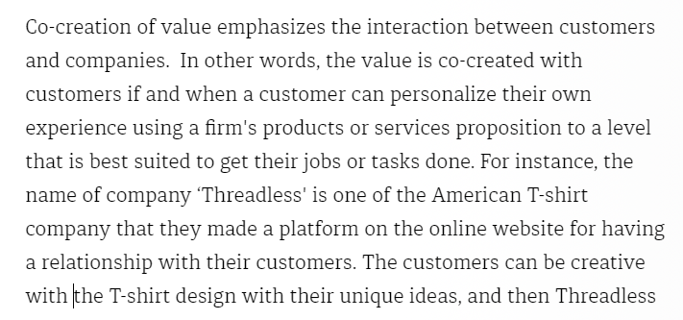
Corrected paragraph

Slide 10
example

Slide 11
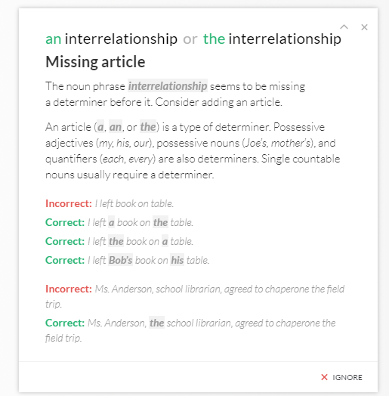
Missing article
This highlights the
importance of proofreading
in the writing process.

Slide 12
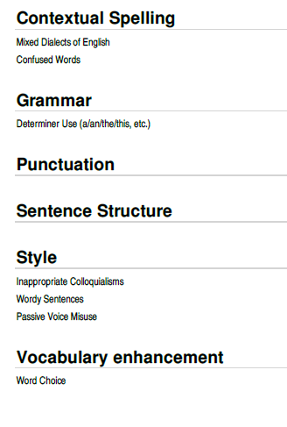
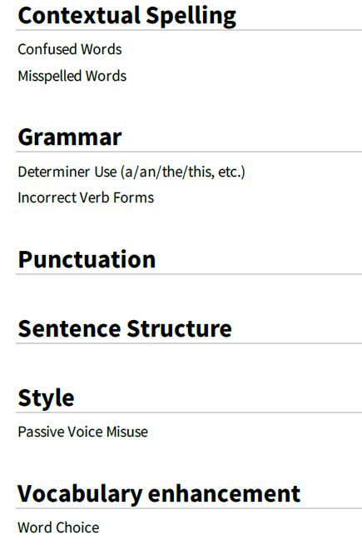
Grammarly reports

Slide 13
Grammarly activity
Notes:
Do students engage with Grammar? I downloaded the activity report and it shows a significant increase in activity from sem 2 2016 to sem 1 2017.

Slide 14
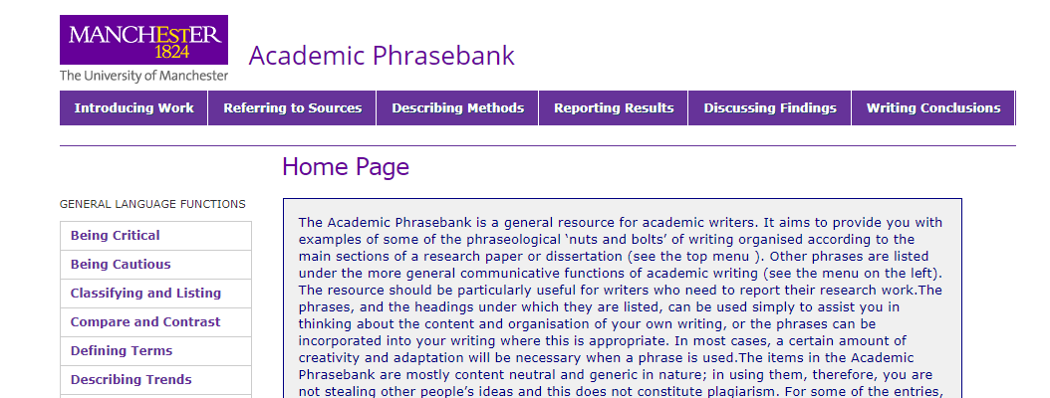
Academic Phrasebank
http://www.phrasebank.manchester.ac.uk
Notes:
Academic Phrasebank - created by John Morley - http://www.phrasebank.manchester.ac.uk/
Draws on John Swales research
Collated by John Morley – phrases were taken from 100 postgraduate dissertations completed at the University of Manchester
The resource should be particularly useful for writers who need to report their research work.The phrases, and the headings under which they are listed, can be used simply to assist you in thinking about the content and organisation of your own writing, or the phrases can be incorporated into your writing where this is appropriate. The Academic Phrasebank draws on the research by John Swales - with examples of some of the phraseological ‘nuts and bolts’ of writing organised according to the main sections of a research paper or dissertation. Phrasebank recognises that there is an important phraseological dimension to academic language and attempts to make examples of this explicit.The resource was designed primarily for academic and scientific writers who are non-native speakers of English.
Native speaker writers may still find much of the material helpful.

Slide 15
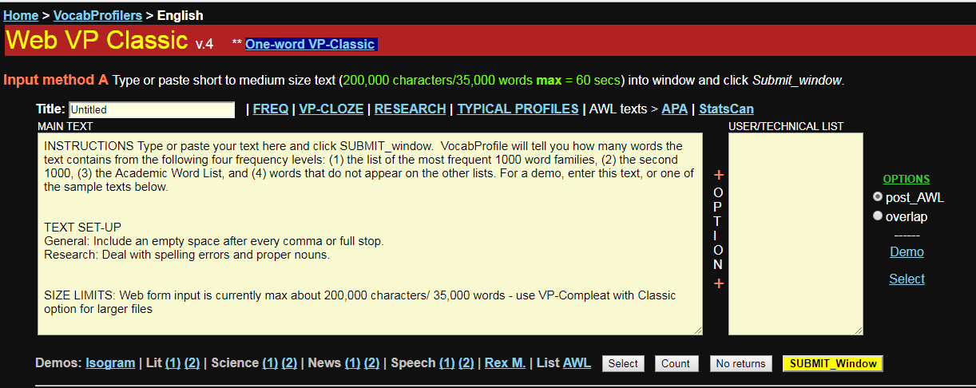
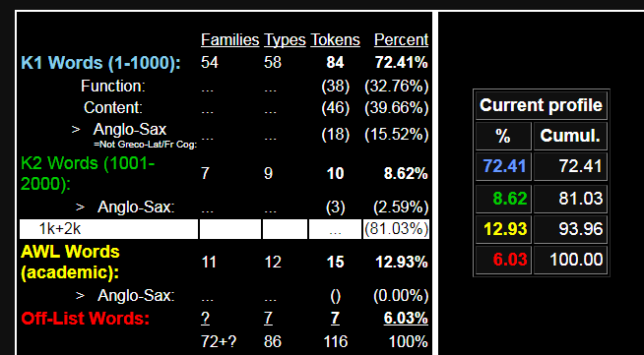
Lextutor
https://www.lextutor.ca/vp/eng/
Lexical text analysis
Notes:
Created by Prof Tom Cobb – Lexical text analysis . Highlights the first 1001 high frequency words, 2nd 1000 high frequency words, and AWL
Vocabprofiler – created by Tom Cobb Professor at the University of Quebec
Lexical text analysis – ist 1000 frequent words, 2nd 1000 frequent words, AWL, other words not found in any list
AWL – 10-15% is typical for an academic text

Slide 16
Turnitin
erater
Notes:
Turnitin – formative feedback– do the plagiarism check.

Slide 17
Skills hub activity
The writing resources/tools
were among the top 10 pages accessed by both
PG and UG students
Notes:
Snapshot of student activity on the Skills Hub

Slide 18
What do students say about the tools?
Notes:
Let’s look specifically at particular tools

Slide 19
Which tools do you use to support your writing?
Implications:
Highest level of engagement with Grammarly.
Minimal engagement with lextutor.
Turnitin and Academic Phrasebank are mainly used by PG students.

Slide 20
How useful have you found these tools?

Slide 21
Why do you use these tools?

Slide 22
How have these tools helped?
improved my academic writing style
notice how phrases are used
Implication
Addresses some of the key issues
identified by DELNA
helped me to embed sources more effectively
use fewer awkward phrases
improved my academic vocabulary
more writing accuracy
Notes:
Addresses some of the key issues identified by DELNA that I mentioned earlier.

Slide 23
What do students say about Grammarly?
…
It helped my writing… from
my first paper to now…
makes you read over more… makes you think about your writing
My criticism is that it missed
actual errors… comma in the
wrong place.
Instant feedback
I didn’t accept some suggestions
Makes you notice things
…commas
Implications
this needs to be explored further
shows an awareness not to accept all the suggestions
Implications
Grammarly feedback is immediate
it makes students think about their writing.
Notes:
The students comments have highlighted some strengths and limitations.

Slide 24
Turnitin
Turnitin is good - when I paraphrased an article it alerted me when I was
not paraphrasing enough.
Academic Phrasebank
Really liked the embedding sources section
and suggestions for reporting verbs
TEXT
HERE
TEXT
HERE
Feedback from tutor was more valuable.
Was amazing - It helped me think about my sentences
Implications
students benefit from using the tools by learning to paraphrase more effectively
Tutor comments valued
Implication
Provides the scaffolding required not only for second language learners but native speakers as well

Slide 25
Summary
Strengths of the study
Majority of students found these tools very useful
Good formative feedback
Can be used as a diagnostic tool to support student academic writing
Limitations
Small study but rich student narrative
A few highlighted some limitations which may be explored further to support student writing
Wider implications
Create a greater awareness within the Business School and the wider university of the available resources
The challenge is how best to support student academic writing through the effective use of these tools and nurture writing independence in the higher education context
.

Slide 26
References
Arkoudis, S. (2008). Taking the role of English language seriously in higher education: Why is it so difficult? Retrieved from www.cshe.unimelb.edu.au/downloads/Sem30Jun2008Slides.pdf.
Chodorow, M., Gamon, M., &Tetreault, J. (2010). The Utility of Article and Preposition Error Correction Systems for English Language Learners: Feedback and Assessment. Language Testing 27(3) . 419-436. Print.
Chodorow, M., Dickinson, M., Israel, R. and Tetreault, J. (2012). Problems in Evaluating Grammatical Error Detection Systems. Proceedings of COLING: Technical Papers. Mumbai, India: COLING, 611-628.
Conroy, M.A. (2010). Internet tools for language learning: university students taking control of their writing. Australasian Journal of Educational Technology 26(6), 861-882.
Coxhead, A. (2000). A new academic word list. TESOL Quarterly, 34, 213–238.
Davies, M. (2008). The Corpus of Contemporary American English: 450 million words, 1990-present. Retrieved from http://corpus.byu.edu/coca/.
Davis, M., & Morley, J. (2011). The role of reusable phrases in postgraduate writing: Multidimensional perspectives. In S. Etherington (Ed.), English for specific purposes (pp. 69–75). BALEAP 2009 Conference Proceedings, Reading. Reading: Garnet.
Davis, M., & Morley, J. (2013). ‘Use your own words!’ Exploring the boundaries of plagiarism in re-usable phrases. In J. Wigglesworth (Ed.). EAP within the Higher Education garden: Cross pollination between disciplines, departments and research (pp. 85–94). BALEAP 2011 Conference Proceedings, Portsmouth. Reading: Garnet.
Gamon, M., Chodorow, M., Leacock, C. and Tetreault, J. (2013). Grammatical Error Detection in Automatic Essay Scoring and Feedback. Handbook of Automated
Essay Evaluation: Current Applications and New 19 Directions (pp.251-266) In M. D, Shermis & J. Burstein(Eds). New York, NY: Routledge.
Gauthier, M. (2013). Anglophone high school boys’ engagement and achievement in editing their French writing using the BonPatronPro. Journal of Classroom Research in Literacy, 6, 24-35.
Hyland K. (2007). Genre pedagogy: Language, literacy and L2 writing instruction. Journal of Second Language Writing, 16, 148–164.
Na-Rae, H., Chodorow, M., & Leacock, C. (2006). Detecting Errors on English Article Usage by Non-Native Speakers. Natural Language Engineering 12(2), 115-129.
Jones, S., Myhill, D., & Bailey, T. (2013). Grammar for writing? An investigation of the effects of contextualised grammar teaching on students’ writing. Reading and writing, 26(8), 1241-1263. doi: 10.1007/s11145-012-9416-1
Nation, I. S. P. (2006). How large a vocabulary is needed for reading and listening? The Canadian Modern Language Review, 63, 59–81.
Perelman, L. (2016). Grammar checkers do not work. A Journal of writing centre scholarship. 40 (7-8).
Swales, J. M., & Feak, C. B. (2012). Academic writing for graduate students: Essential tasks and skills (3rd ed.). Ann Arbor: University of Michigan Press.
Swales, J. M., & Feak, C. B. (2001). Academic Communications and the Graduate Student. Pedagogy, 1(1), 176.
Qassemzadeh, A., & Soleimani, H. (2016). The impact of feedback provision by grammarly software and teachers on learning passive structures by Iranian EFL learners. Theory and Practice in Language Studies, 6(9), 1884-1894. doi:http://dx.doi.org.ezproxy.auckland.ac.nz/10.17507/tpls.0609.23

Slide 27
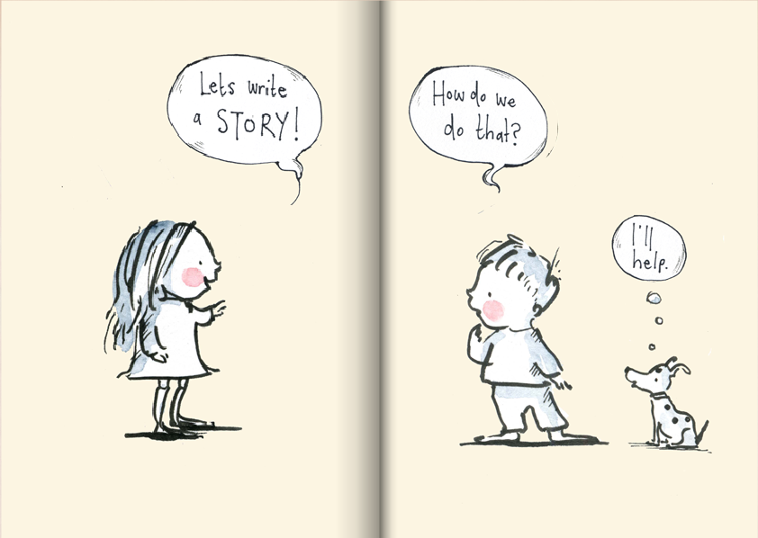
Thank you

