Slide 1
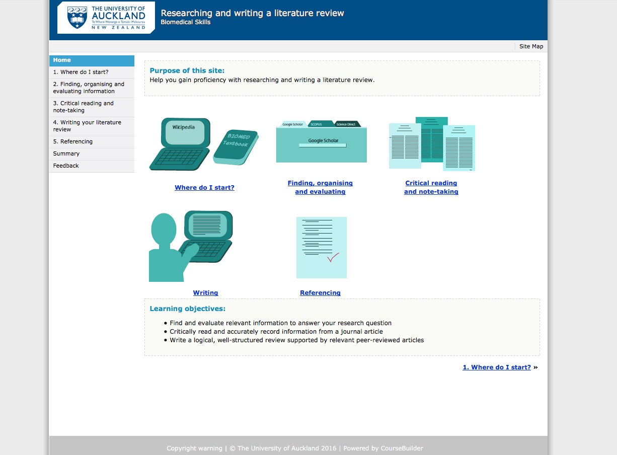
1-2-3 Literature Review
Anuj Bhargava
CLeaR Fellow, 2017
Faculty of Medical and Health Sciences

Slide 2
Listening to student voices
Medsci 311: Cardiovascular Biology (Semester 1; 72 students)
10% assignment
  Write a literature review on a “current hot cardiovascular” topic
Big step-up
  Even for high-performing students
Despite strict guidelines, “hand holding” emails and face-to-face chats…
Suggestion of a website that “shows us how”
Notes:
-

Slide 3
The journey
Paper prototype and draft web tool
Initial evaluation
  Teacher peers
  Postgraduate students
Reflection → 2nd iteration
  Animations and activities were added
Beta testing
  Former Stage II and III students
Implementation in a Semester 1 class

Slide 5
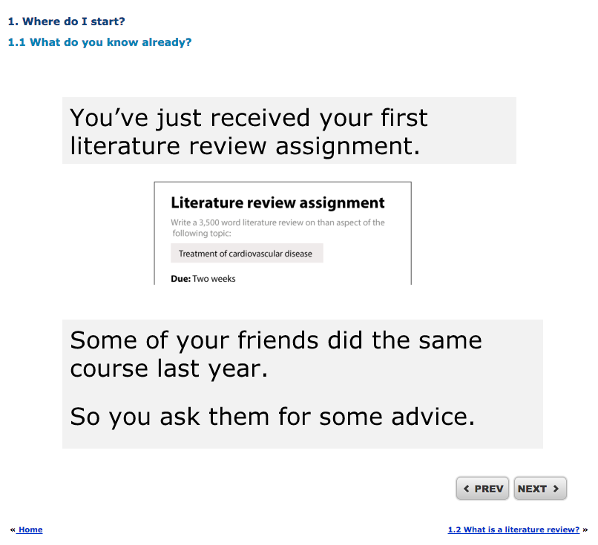

Slide 6
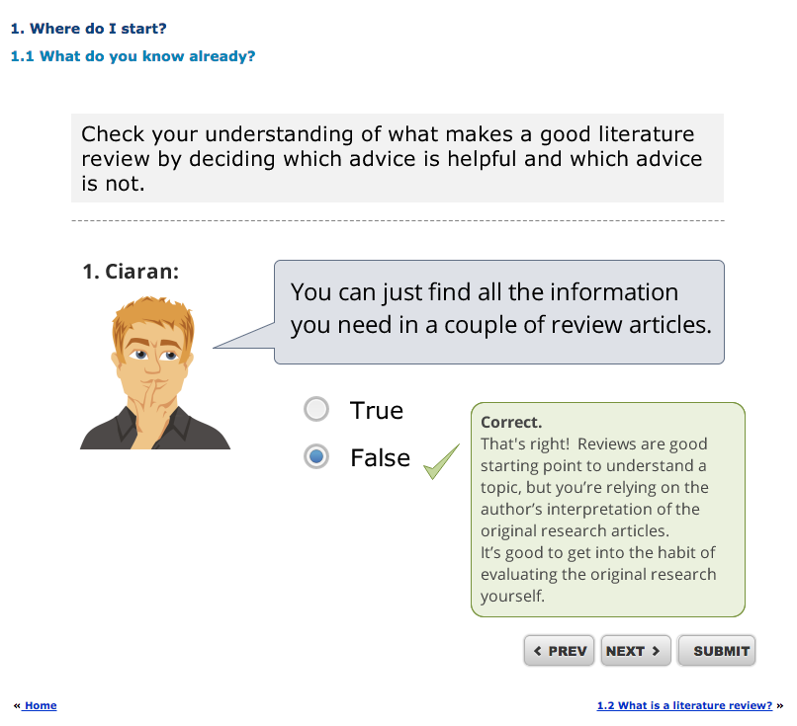

Slide 7
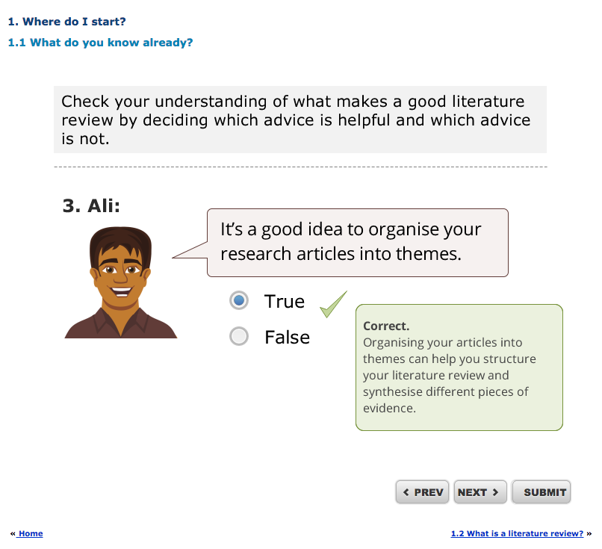
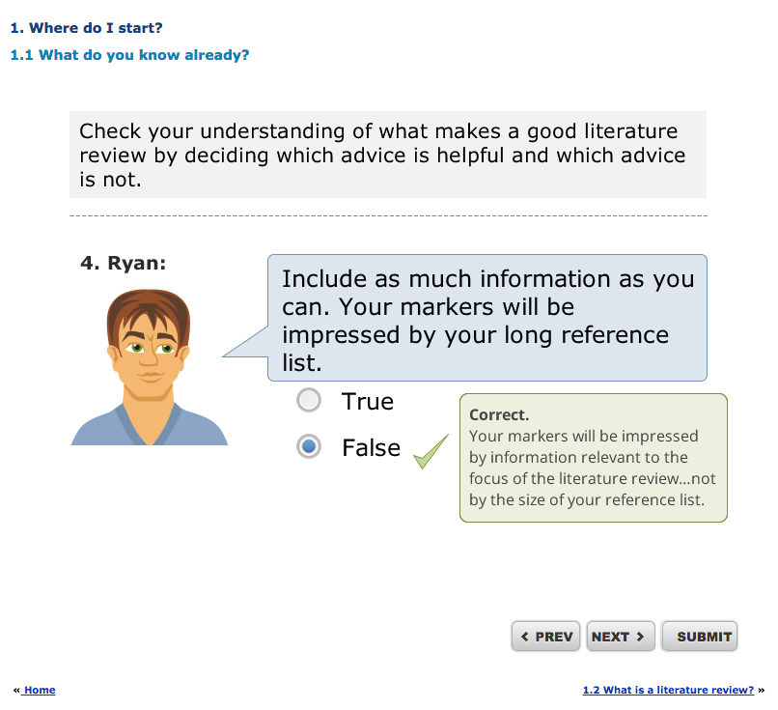

Slide 8
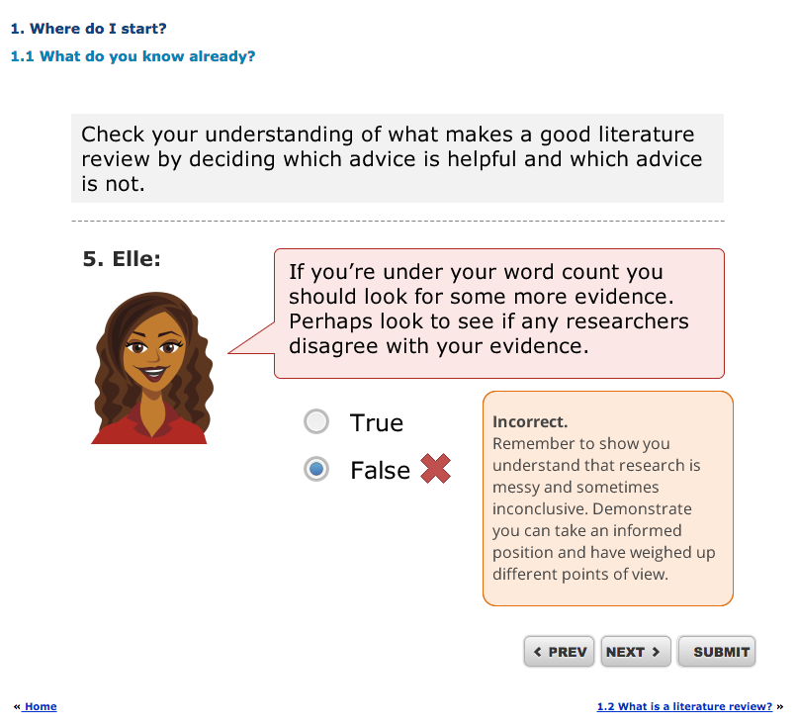

Slide 9
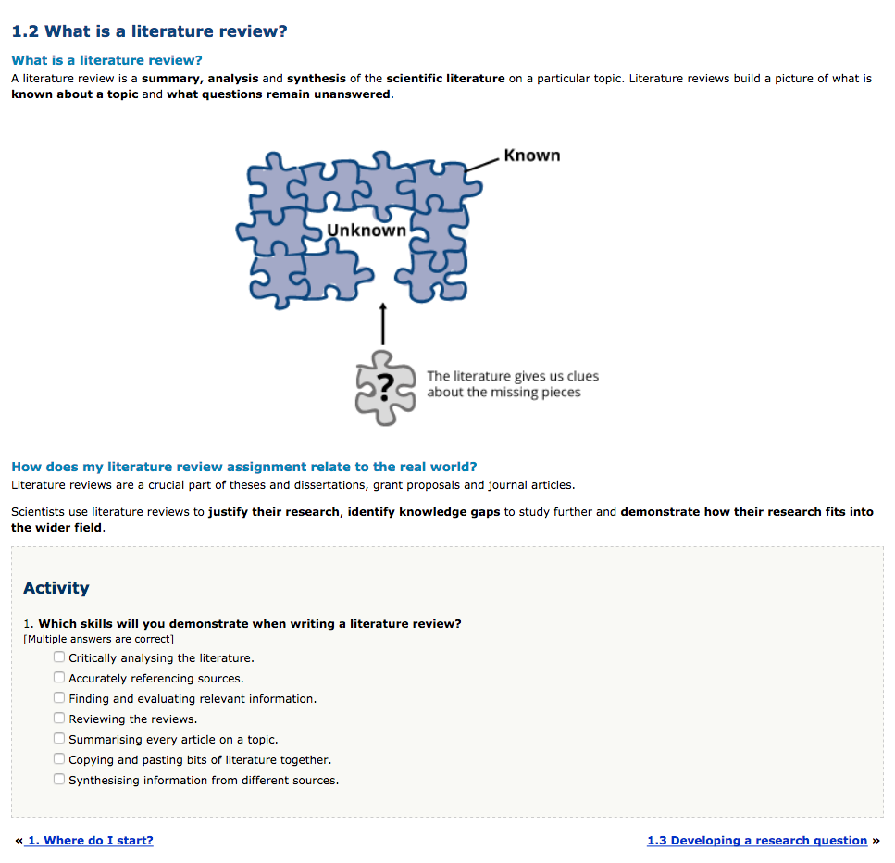

Slide 10
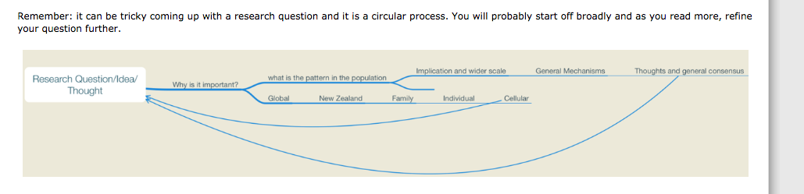
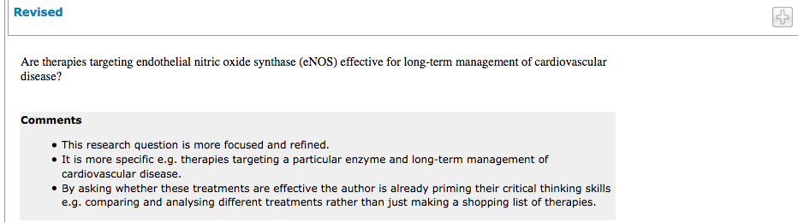
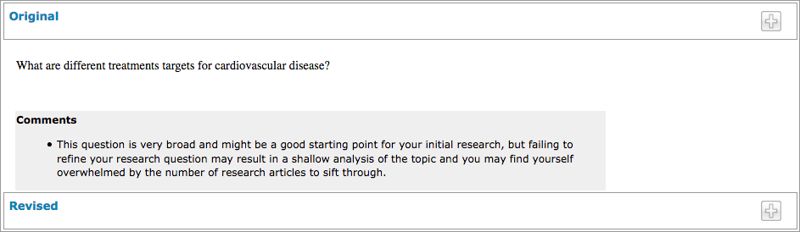

Slide 11
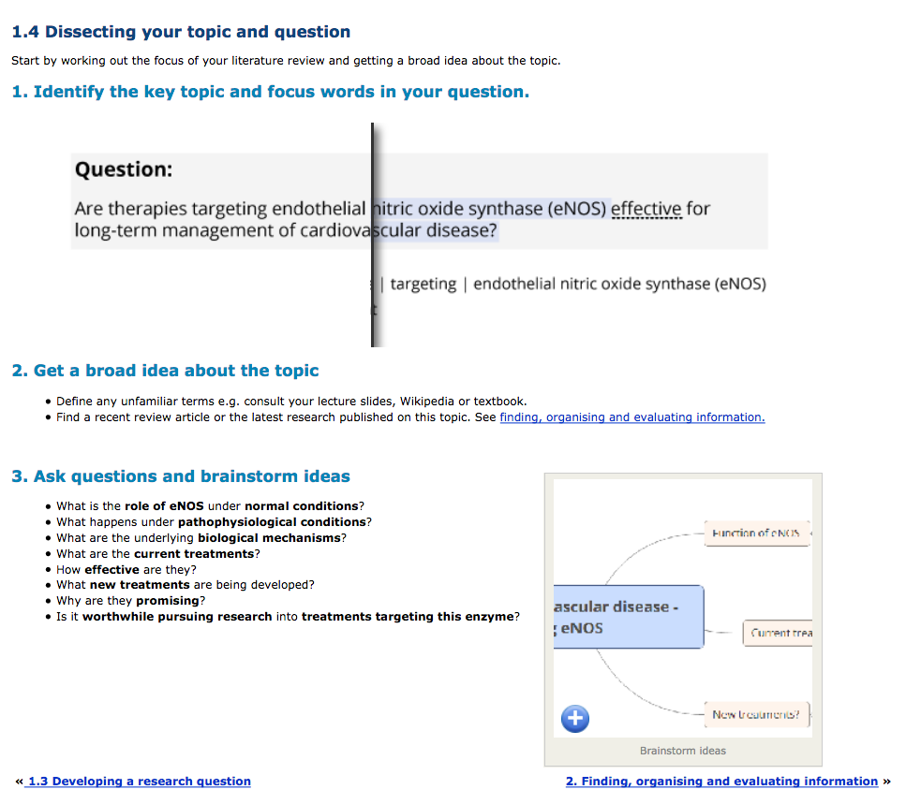

Slide 12
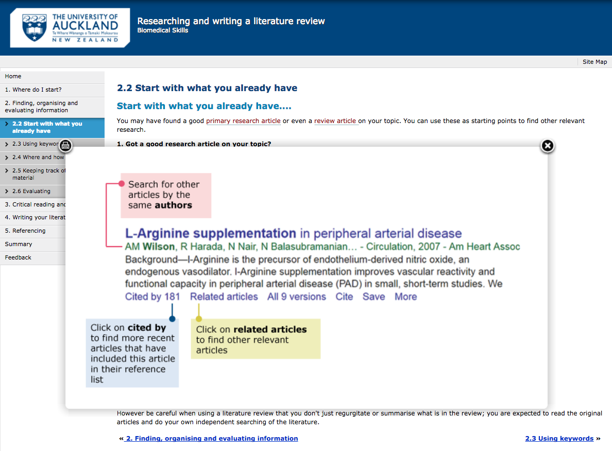

Slide 13
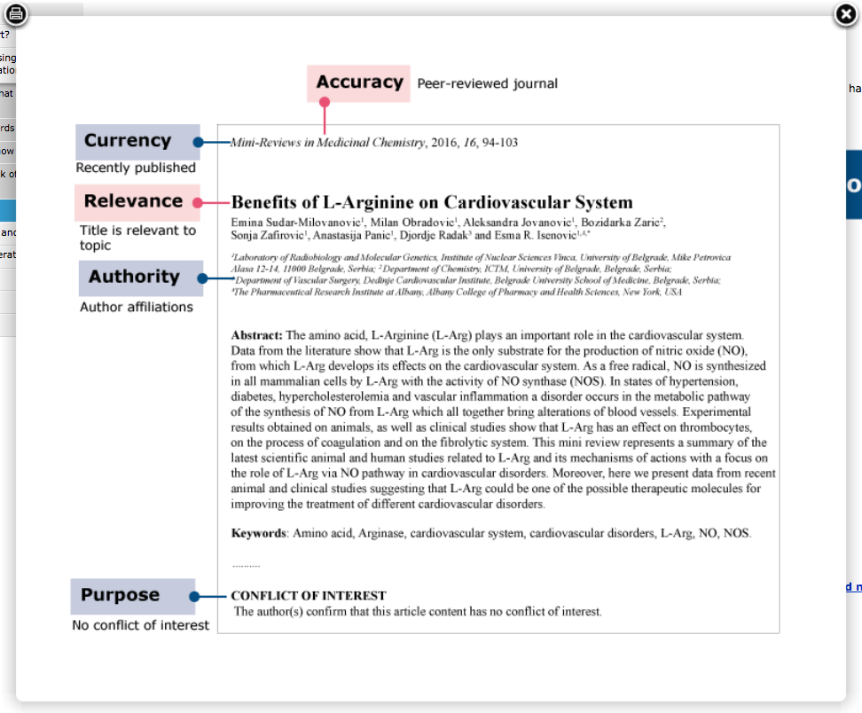
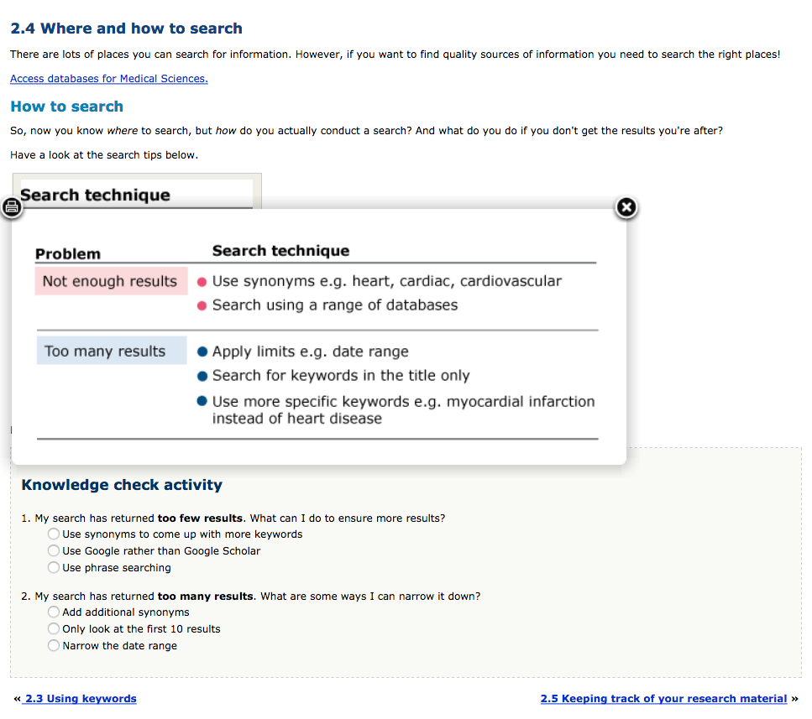

Slide 14
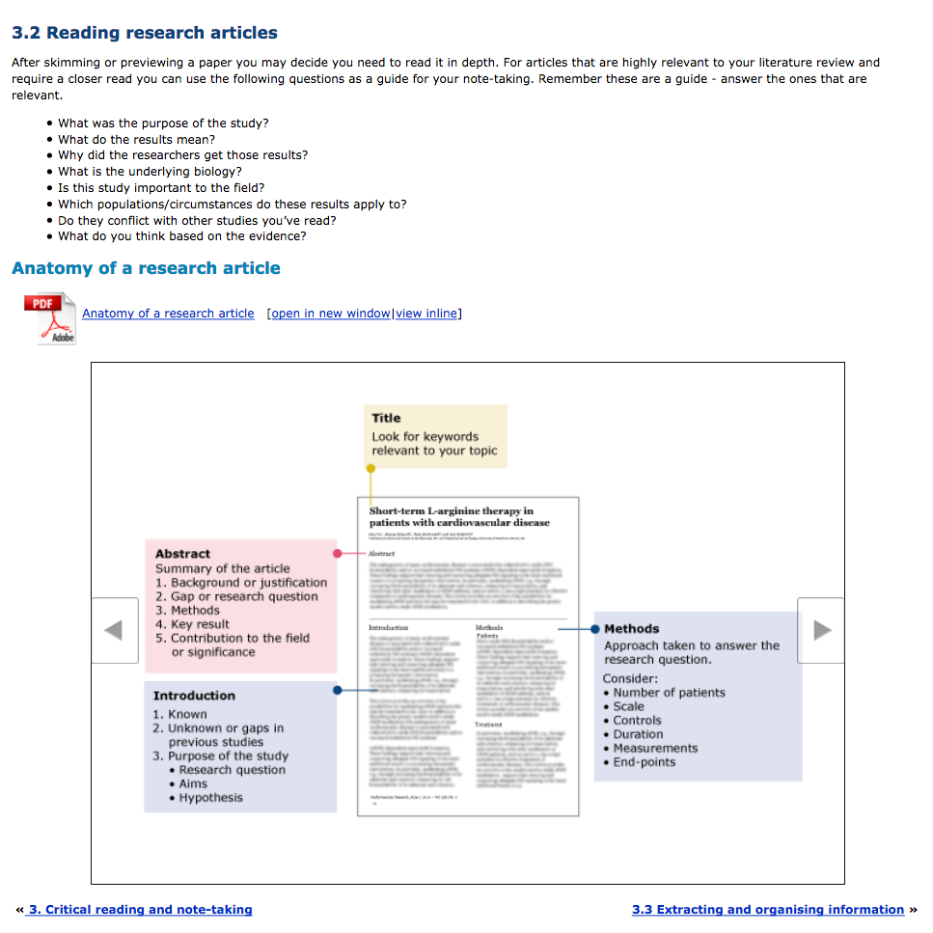

Slide 15
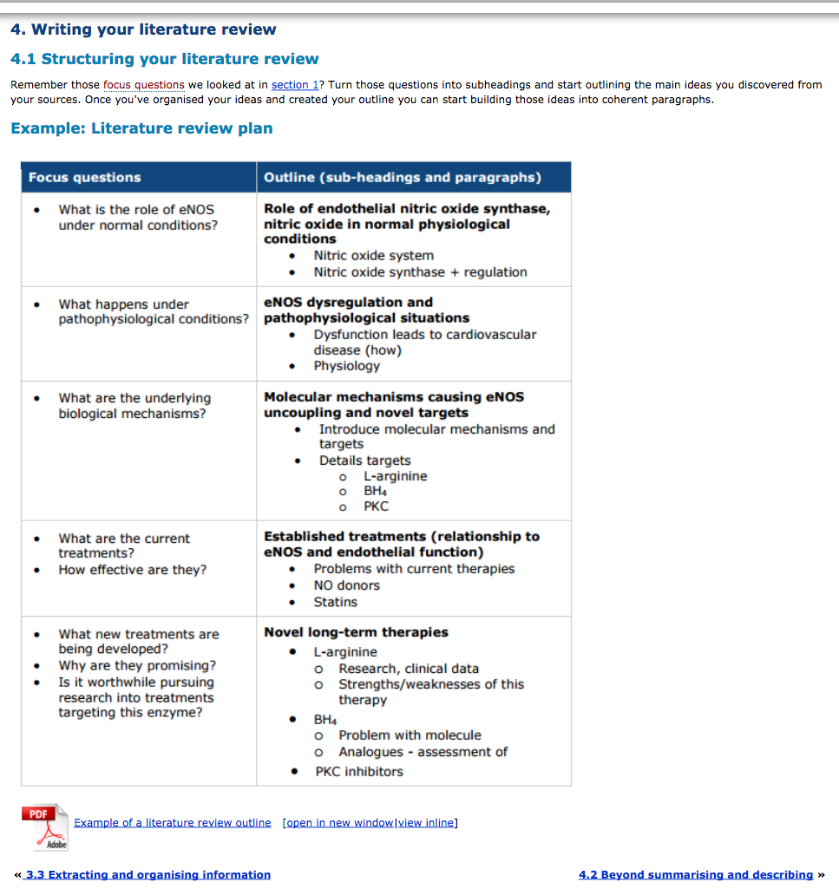
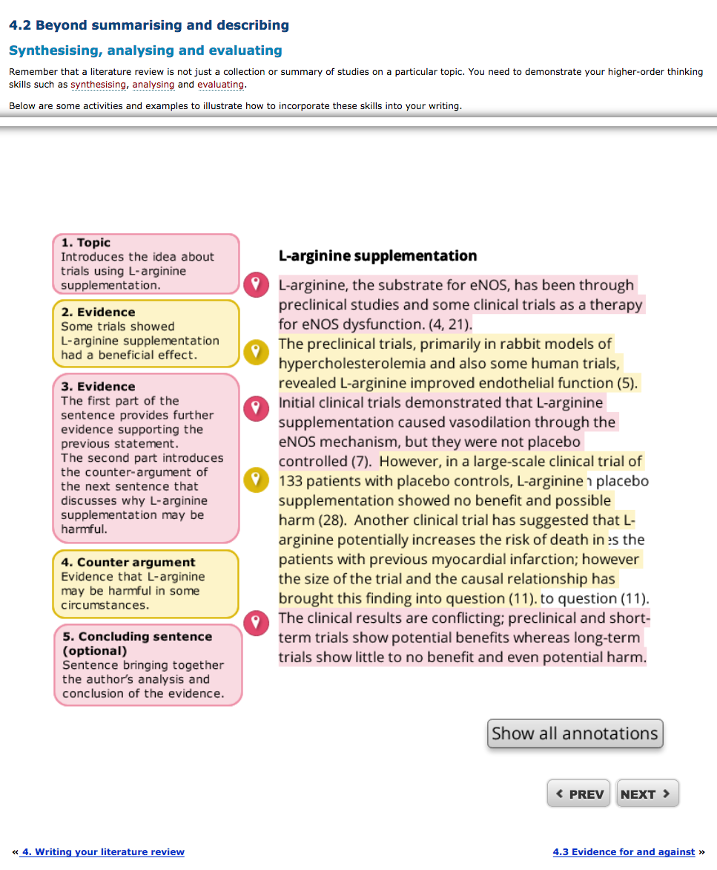

Slide 16
Evaluation: The Litmus Test
Sample: current cohort of Medsci 311 students
11 questions survey adapted from the UoA eLearning questionnaire
Open text comments
32 / 71 (45%) students participated

Slide 17
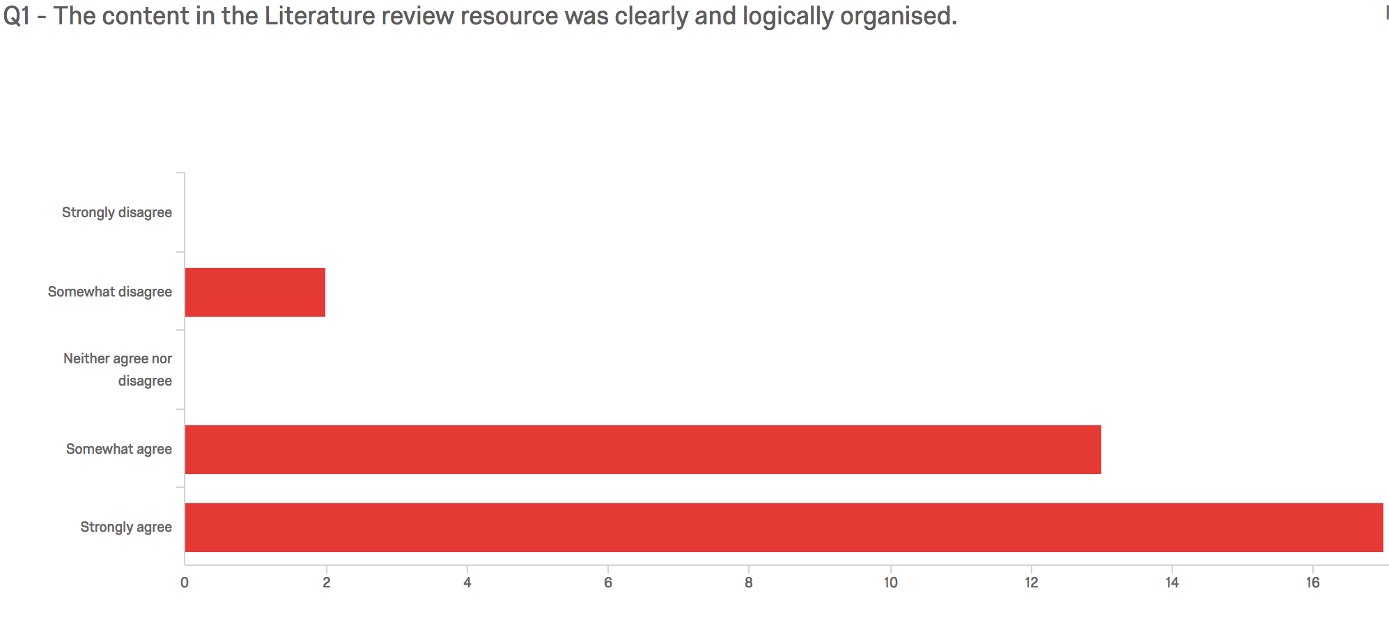

Slide 18
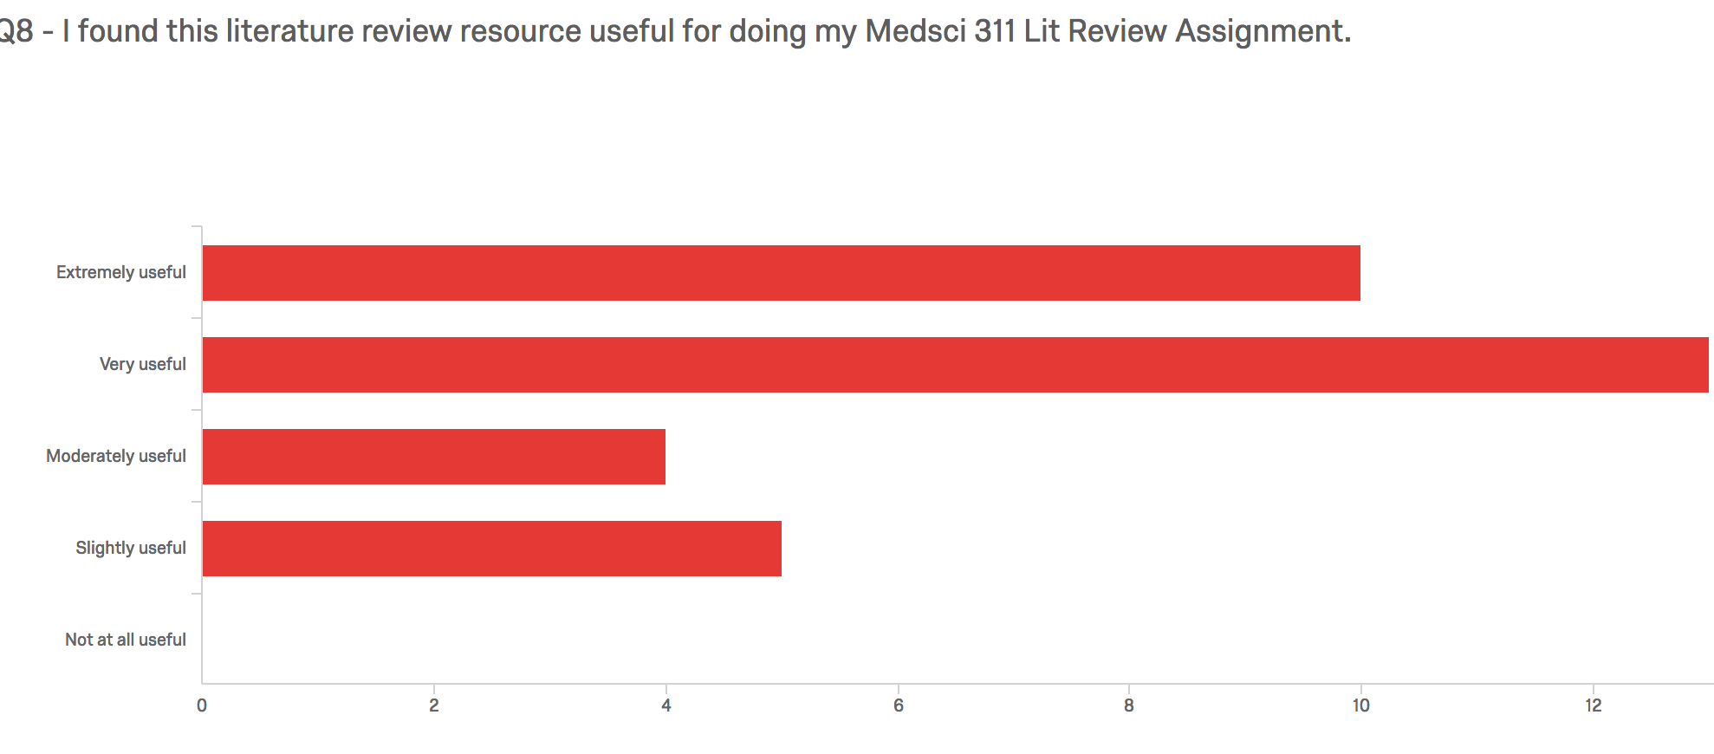

Slide 19
Selected comments

Slide 20
Journey Continues
Implementation in a Semester 2, Stage III course
  Semester 1, 2018: incoming Honours and returning post graduate students
  Promotion & implementation in other FMHS courses with similar assessments
Collaborative design & promotion (Library Learning Services Staff)
IUPS attendance: poster presentation
Notes:
A similar

Slide 21
Self Reflection-
MY CLeaR Fellowship journey- Creation, Collaboration and Contribution
Students reflection-
Rose Gannaway, Callum Tatton and Peter Wills

